Slide 1
Check Yourself Before You Wreck Yourself
Auditing and Improving the Performance of Boomerang

Slide 2

Why are we here today?
Boomerang: an open-source Real User Monitoring (RUM) third-party library
https://github.com/akamai/boomerang
Why performance matters to us
Performance Audit
Improvements!
Testing, Validation, Protecting against Regressions

Slide 3
Why should you care?
Do you develop a library that other teams, companies or projects use?
Do you use a third-party library?
Any library that you didn't write
They might be packaged in your application’s JavaScript bundle, included via a cross-origin <script> tag, or injected via a tag manager.
Boss: Developer, please add this fancy new script!
<script async src="//cdn.remarketing.com/js/foo.min.js"></script>
What could go wrong? It’s just one simple line!

Slide 4
What can go wrong?
<script async src="//cdn.remarketing.com/js/foo.min.js"></script>
That one little line can:
Cause your page to stop loading
Slow down other components
Create incompatibilities with other libraries
Change from underneath you
Take total control of your site

Slide 5
Boomerang
14,000+ mPulse sites
> 1 billion page loads a day
76,000 - 460,000 sites using open-source boomerang.js (estimate)
https://discuss.httparchive.org/t/who-are-the-top-rum-analytics-providers/ https://trends.builtwith.com/javascript/Boomerang

Slide 6
Evaluating the Cost of a 3rd Party
“Everything should have a value, because everything has a cost” - @tkadlec
How can we judge the cost of a script?
$ ls -al modernizr.js* -rw-r--r--@ 1 nicjansma staff 92,475 May 30 20:20 modernizr.js -rw-r--r-- 1 nicjansma staff 32,599 May 30 20:21 modernizr.js.gz
… it’s... cheap???

Slide 7
Resource Weight
A third-party’s size (bytes) contributes to the overall Page Weight.
Page Weight is important - it has an effect on how long the page takes to load, especially on lower-end devices or slower connections.
Lowering the Page Weight can improve load times, so you want to factor the byte cost of a third-party into your overall Performance Budget.
… but while it’s the easiest way to judge a third party, it’s just one aspect of the overall cost.

Slide 8
A 3rd-Party Script’s Lifecycle & Costs
Loader Snippet / <script>
Download
Parse + Compile
Initialize
Runtime / event handlers

Slide 9
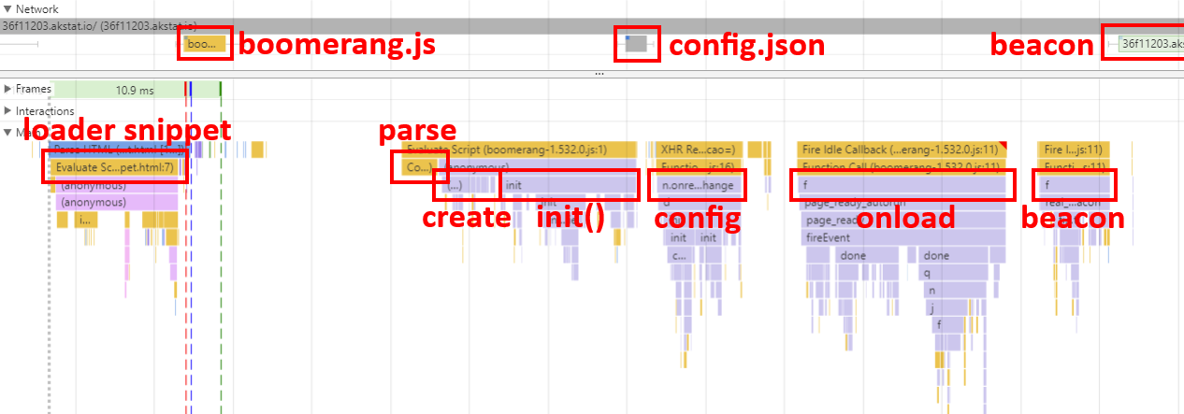
Boomerang Performance Audit

Slide 10
Boomerang Performance Audit
Loader Snippet / <script>
Download
Parse + Compile
Initialize
Runtime / event handlers

Slide 11
A 3rd-Party Script’s Lifecycle
Loader Snippet / <script>
Download
Parse + Compile
Initialize
Runtime / event handlers
Critical path!
Script tag itself has no cost: <script src="..."></script>
Snippets have a cost (2-10ms on desktop Chrome):
<script type="text/javascript"> (function() { var po = document.createElement('script'); po.type = 'text/javascript'; po.async = true; po.src = 'https://.../foo.js'; var s = document.getElementsByTagName('script')[0]; s.parentNode.insertBefore(po, s); })(); </script>

Slide 12
Boomerang's Loader Snippet
Loader Snippet / <script>
Download
Parse + Compile
Initialize
Runtime / event handlers
Boomerang's Loader Snippet
Completely async and non-blocking
Better than <script async>
Cost: 2-40ms
More expensive than <script>, but guaranteed to not block
https://akamai.github.io/boomerang/tutorial-loader-snippet.html

Slide 13
A 3rd-Party Script’s Lifecycle
Loader Snippet / <script>
Download
Parse + Compile
Initialize
Runtime / event handlers
Every byte affects overall page weight.
Critical path?
External <script> / tag: no (unless sharing domain)
Bundled with other components: yes?
Load from a CDN!
The script may load additional resources.

Slide 14
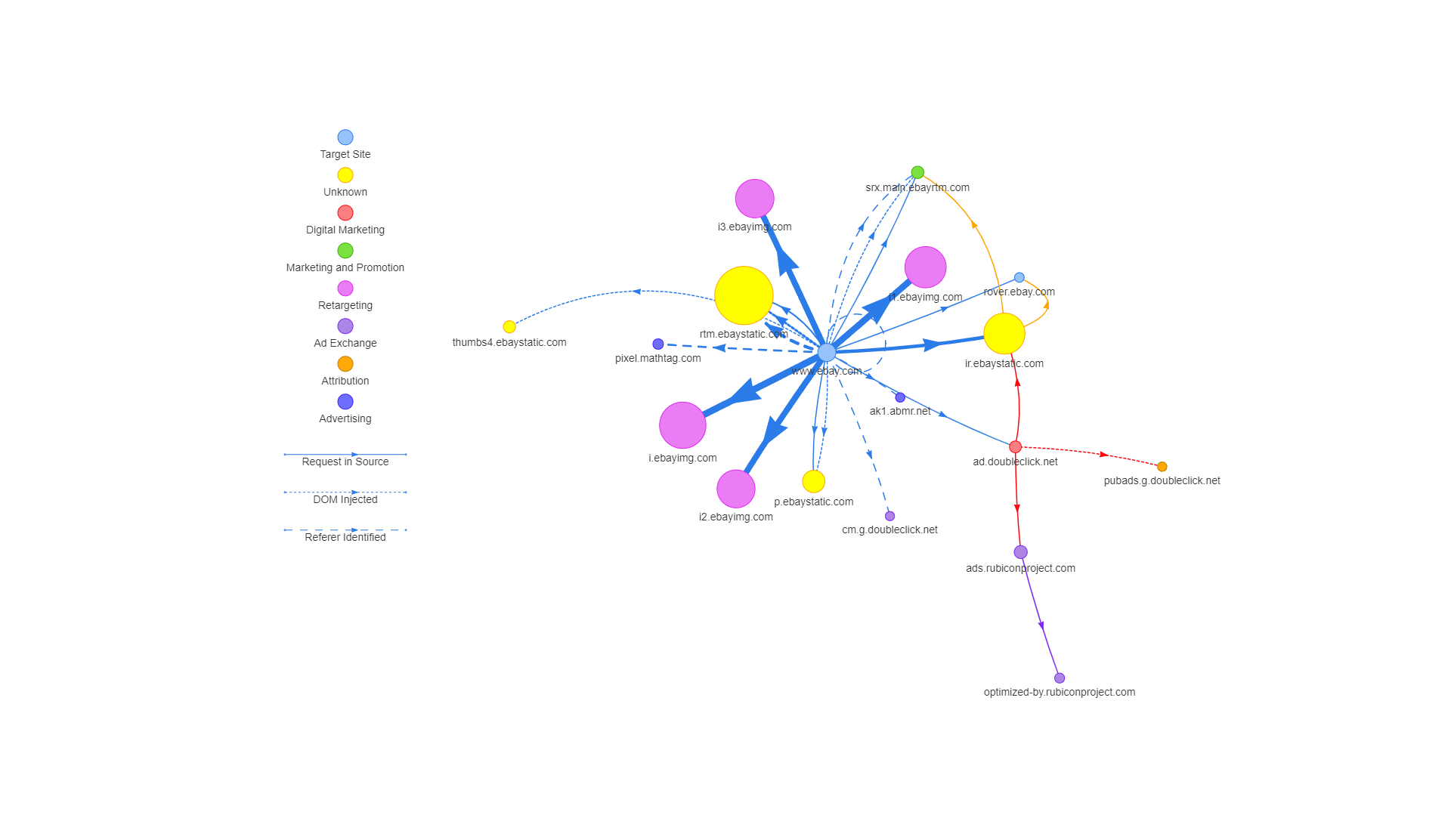
A 3rd-Party Script’s Lifecycle
Loader Snippet / <script>
Download
Parse + Compile
Initialize
Runtime / event handlers
//requestmap.webperf.tools

Slide 15
A 3rd-Party Script’s Lifecycle
Loader Snippet / <script>
Download
Parse + Compile
Initialize
Runtime / event handlers
underscore.js 7 KB
Google Analytics 14 KB
moment 16 KB
jQuery 29 KB
React 32 KB
Twitter 34 KB
Boomerang 47 KB
Angular 59 KB
D3 71 KB

Slide 16
A 3rd-Party Script’s Lifecycle
Loader Snippet / <script>
Download
Parse + Compile
Initialize
Runtime / event handlers
Boomerang is built with a plug-in architecture and you can build smaller builds if you'd prefer.
For example, if you don't need: SPA, XHR, UserTiming or Error Tracking support Boomerang shrinks from 47 KB to 26 KB.

Slide 17
A 3rd-Party Script’s Lifecycle
Loader Snippet / <script>
Download
Parse + Compile
Initialize
Runtime / event handlers
Critical path!
After being fetched, the browser must parse / compile the (decompressed) JavaScript before it’s executed.
Less bytes = less parse / compile.
Moment 5 ms 143 KB
Boomerang 10 ms 188 KB
Twitter Widget 10 ms 227 KB
jQuery 11 ms 265 KB
Angular 22 ms 1291 KB

Slide 18
A 3rd-Party Script’s Lifecycle
Loader Snippet / <script>
Download
Parse + Compile
Initialize
Runtime / event handlers
Critical path!
Many scripts will initialize (do some work) at startup - create structures, globals, hook events, etc.
moment 2 ms
jQuery 9 ms
Boomerang 10 ms
Angular 12 ms
Twitter Widget 20 ms

Slide 19
A 3rd-Party Script’s Lifecycle
Loader Snippet / <script>
Download
Parse + Compile
Initialize
Runtime / event handlers
Critical path!
The library should be there for a reason.
This reason will do work periodically or based on user interactions.
SPA framework updating the view after a route change
Analytics scripts sending beacons
Charting library responding to user interactions

Slide 20
A 3rd-Party Script’s Lifecycle
Loader Snippet / <script>
Download
Parse + Compile
Initialize
Runtime / event handlers
Boomerang: depending on the site, 10-40ms at onload
Upwards of 300ms on resource-heavy sites on low-end devices

Slide 21
A 3rd-Party Script’s Lifecycle
Loader Snippet / <script>
Download
Parse + Compile
Initialize
Runtime / event handlers
Critical path!
All bold could be done on the main thread (depending on the browser) and can can cause Long Tasks.

Slide 22
Long Tasks and Time to Interactive
A task is work the browser is doing to build the page, such as parsing HTML, executing JavaScript, or performing layout. This happens on the main thread.
The browser cannot respond to user input (clicking, scrolling, etc) while executing a task.
Long Tasks are due to complex work that requires more than 50ms of execution time. i.e. parsing or executing complex JavaScript.
Long Tasks will delay Time to Interactive - the point at which your app is responsive.

Slide 23
Boomerang’s Performance Audit
https://nicj.net/an-audit-of-boomerangs-performance/
TL;DR boomerang’s 2018 cost (high-end to low-end devices):
Loader Snippet 2 - 40 ms
Download 188 KB raw / 47 KB gzip (non-blocking)
Parse 6 - 47 ms
Initialize 3 - 15 ms
@onload 10 - 300 ms
Beacon 2 - 20 KB
Runtime minimal
Tracking improvements @ https://github.com/akamai/boomerang/issues

Slide 24
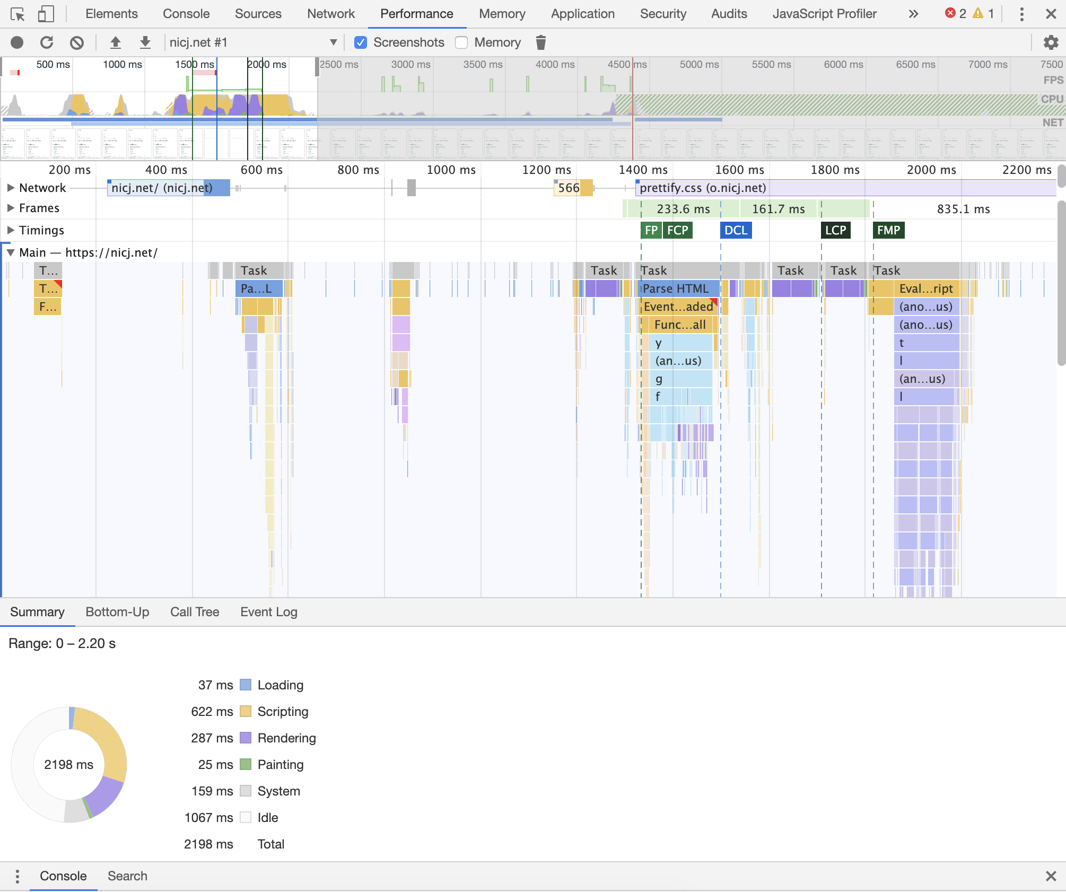
Performance Audit Tools
Developer tools are your friend!
Profilers can point to opportunities
My advice:
Take your time
Get a sense for the overall picture
Look for extremes - longest duration, tallest stack

Slide 25
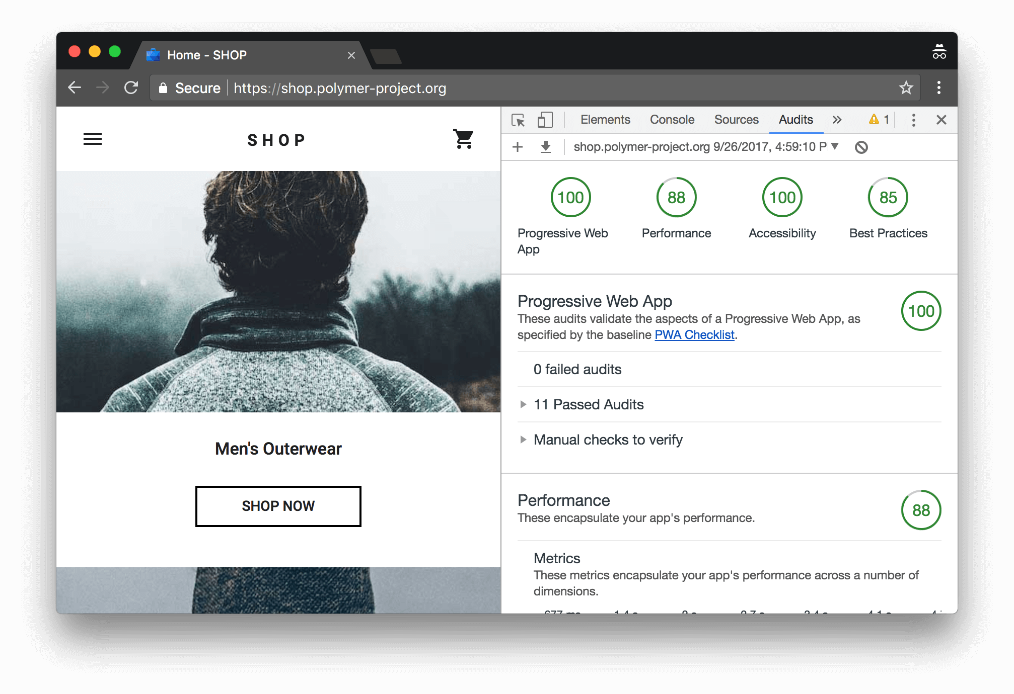
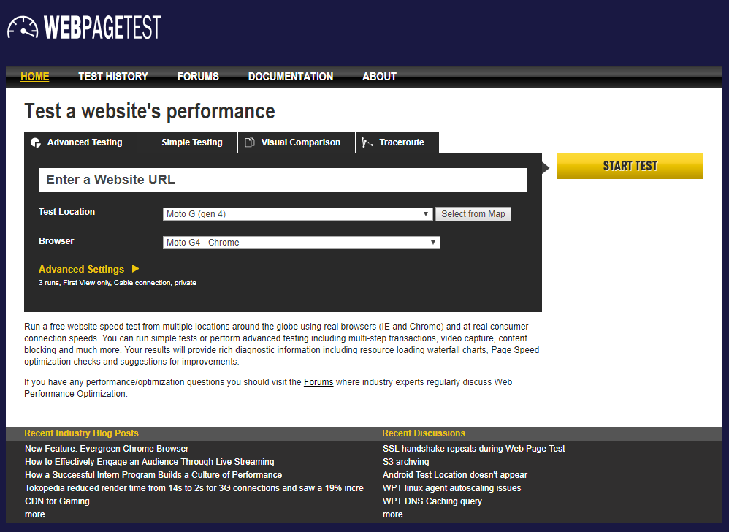
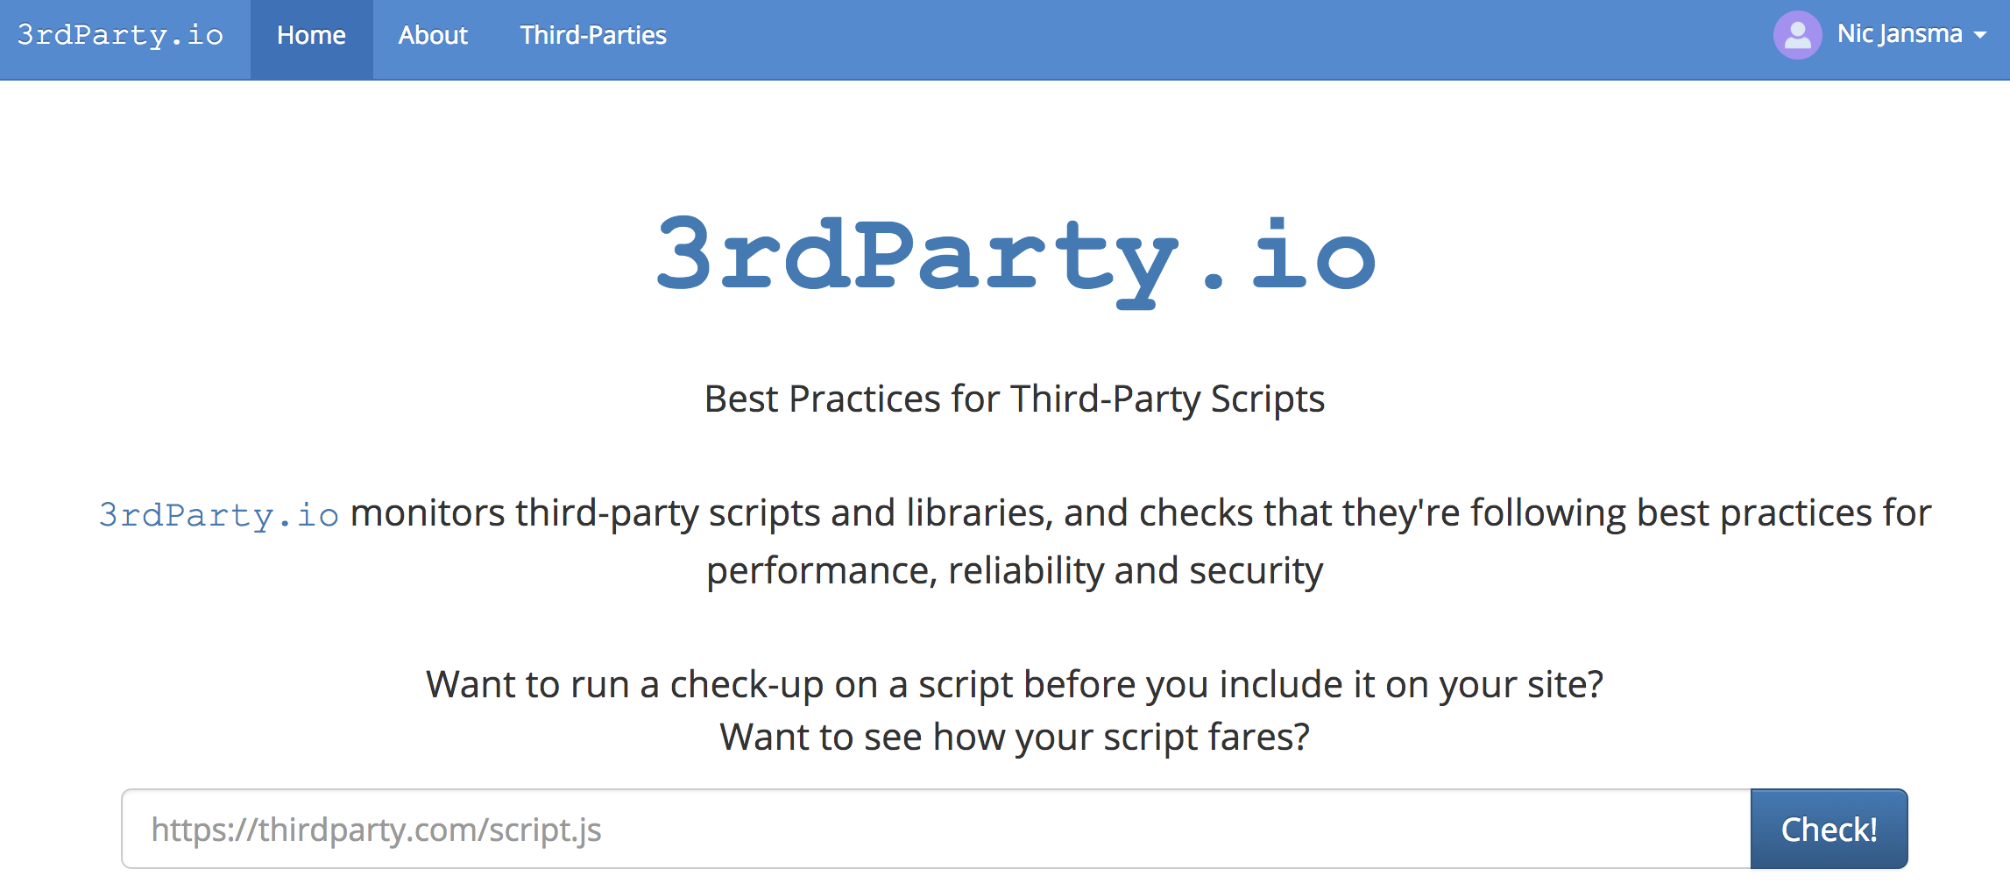
Evaluating for Performance
Chrome Lighthouse
developers.google.com /web/tools/lighthouse/
RequestMap
requestmap.webperf.tools
WebPagetest
webpagetest.org
3rdParty.io
3rdparty.io

Slide 26
Boomerang’s Performance Audit
https://nicj.net/an-audit-of-boomerangs-performance/
We found room for improvement! Filed 15 issues. Examples:
ResourceTiming Compression is expensive
Loader Snippet Performance in Edge
Breakup plugin creation / initialization to avoid long tasks
Beacon: Review cookie access
Beacon: Memory: Node counting is expensive
Unload beacon size
Unload Beacon: Memory plugin updating DOM counts
Tracking improvements @ https://github.com/akamai/boomerang/issues

Slide 27
Boomerang’s Performance Improvements
https://nicj.net/boomerang-performance-update/
New Loader Snippet
ResourceTiming Optimization
Removed Debug Messages
Improved Minification
Reduced Cookie Size
Reduced Cookie Access
Simplified MD5 plugin
Simplified SPA plugin
Enabled Brotli for CDN
Using <link rel="preload"> we can load async and non-blocking without an IFRAME
Reduced 2-40ms to 1ms for browsers that support Preload!

Slide 28
Boomerang’s Performance Improvements
https://nicj.net/boomerang-performance-update/
New Loader Snippet
ResourceTiming Optimization
Removed Debug Messages
Improved Minification
Enabled Brotli for CDN
Reduced Cookie Size
Reduced Cookie Access
Simplified MD5 plugin
Simplified SPA plugin
Compressing ResourceTiming data was our most expensive task
Tweaked the algorithm slightly to be slightly-less-than-perfect for a 4x speedup
Reduced some sites' cost from 100ms to 25ms or 300ms to 75ms

Slide 29
Boomerang’s Performance Improvements
https://nicj.net/boomerang-performance-update/
New Loader Snippet
ResourceTiming Optimization
Removed Debug Messages
Improved Minification
Enabled Brotli for CDN
Reduced Cookie Size
Reduced Cookie Access
Simplified MD5 plugin
Simplified SPA plugin
We were shipping debug log messages even though the debug log was disabled (6% saving)
Changed from Uglify2 to Uglify3 (1.3% saving)
Enabled Brotli on the Akamai CDN (11.2% saving)
SPA and MD5 plugins refactored (2.8% saving)

Slide 30
Boomerang’s Performance Improvements
https://nicj.net/boomerang-performance-update/
New Loader Snippet
ResourceTiming Optimization
Removed Debug Messages
Improved Minification
Enabled Brotli for CDN
Reduced Cookie Size
Reduced Cookie Access
Simplified MD5 plugin
Simplified SPA plugin
We set a cookie to track sessions
Changed how we stored some of the data (e.g. hash instead of a full URL, Base36 instead of Base10 for numbers): 41% smaller
We were reading/writing constantly during startup -- simplified our operations from 21 reads and 8 writes down to 2 reads and 4 writes

Slide 31
Boomerang’s Performance Improvements
https://nicj.net/boomerang-performance-update/
New Loader Snippet
ResourceTiming Optimization
Removed Debug Messages
Improved Minification
Enabled Brotli for CDN
Reduced Cookie Size
Reduced Cookie Access
Simplified MD5 plugin
Simplified SPA plugin
We were using MD5 for hashing and comparing URLs quickly
This plugin took 8.1 KB and could hash 35,397 URLs/sec
We replaced with the FNV algorithm: 0.34 KB and 113,532 URLs/sec
SPA plugin was simplified and removed framework-specific support in favor of just monitoring the window.History object

Slide 32
Boomerang’s Performance Audit
https://nicj.net/boomerang-performance-update/
After fixes:
Loader Snippet 2 - 40 ms 1-20 ms (1 ms in modern browsers)
Download 188 KB raw / 47 KB gzip 196 KB raw / 47 KB brotli
Parse 6 - 47 ms (same)
Initialize 3 - 15 ms (same)
@onload 10 - 300 ms 5-75 ms
Beacon 2 - 20 KB (same)
Runtime minimal
Tracking improvements @ https://github.com/akamai/boomerang/issues

Slide 33
Boomerang’s Performance Audit
https://nicj.net/boomerang-performance-update/
Opportunities!
Loader Snippet 2 - 40 ms 1-20 ms (1 ms in modern browsers)
Download 188 KB raw / 47 KB gzip 196 KB raw / 47 KB brotli
Parse 6 - 47 ms (same)
Initialize 3 - 15 ms (same)
@onload 10 - 300 ms 5-75 ms
Beacon 2 - 20 KB (same)
Runtime minimal
Tracking improvements @ https://github.com/akamai/boomerang/issues

Slide 34
Continuous, Gradual Improvement
In a mature product with a healthy process you're much more likely to see a 50% gain come in the form of many 5% gains compounding to get to your goal via sustained effort and quality control
https://docs.microsoft.com/en-us/archive/blogs/ricom/the-performance-war-win-it-5-at-a-time

Slide 35
Protecting Against Regressions
Boomerang Performance Lab / Test Suite
Simple set of scenarios & metrics we capture each build
Tracks:
CPU time via headless Profiler
Counts & Durations via UserTiming marks & measures
Sizes of code & plugins
https://akamai.github.io/boomerang/tutorial-perf-tests.html

Slide 36
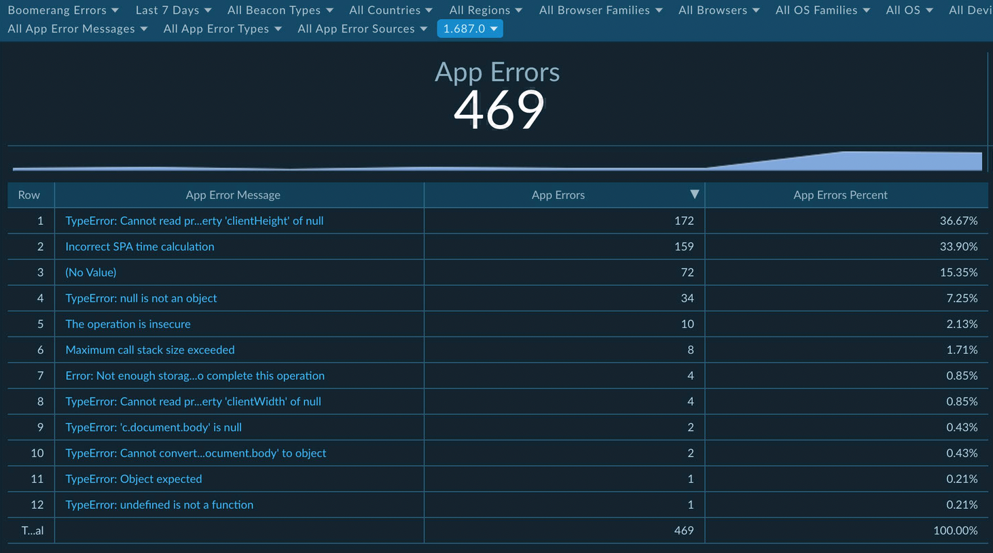
Realtime Telemetry
You can capture your script's own runtime stats, Long Tasks and JavaScript errors
JavaScript Self Profiling API

Slide 37
What can you do?
Boss: Developer, please add this fancy new script!
<script async src="//cdn.remarketing.com/js/foo.min.js"></script>
Perform a light-weight audit
Do its benefits outweigh its costs?
Ask if the library has published performance information
Every third-party should have an owner or “internal champion”

Slide 38
What 3rd Party Scripts Should be Doing...
Minimal:
JavaScript size
Work without yielding
Network latency
CPU
Requests
Cookies
DOM changes / additions
Event hooks
Global variables
Patching
Changes without your permission
No:
document.write()
alert() or prompt()
eval()
debugger;
Console messages
JavaScript errors
Including other libs
Redirects
Known vulnerabilities
They should:
Use a CDN
Compress resources
Set caching headers
Set Timing-Allow-Origin
Set ACAO
Support HTTPS
Support HTTP/2
Minify
Have ~100% uptime

Slide 39
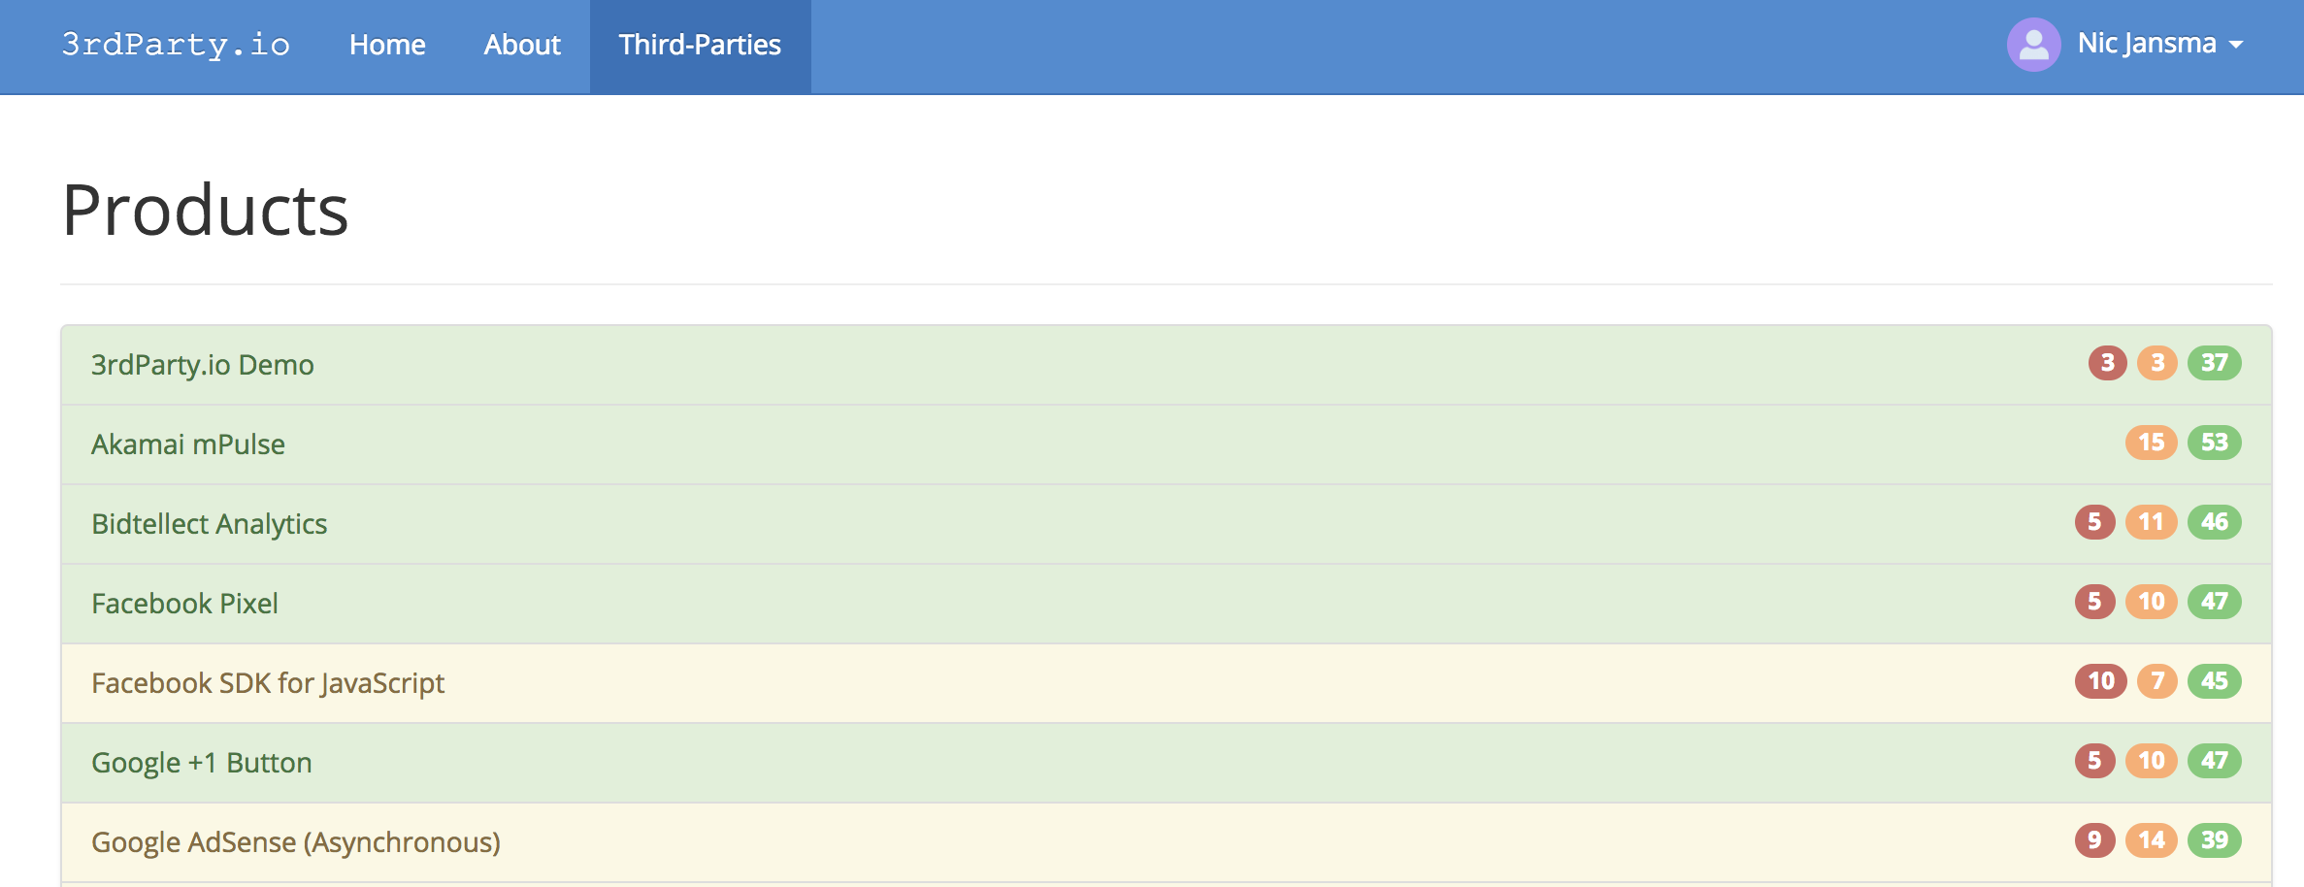
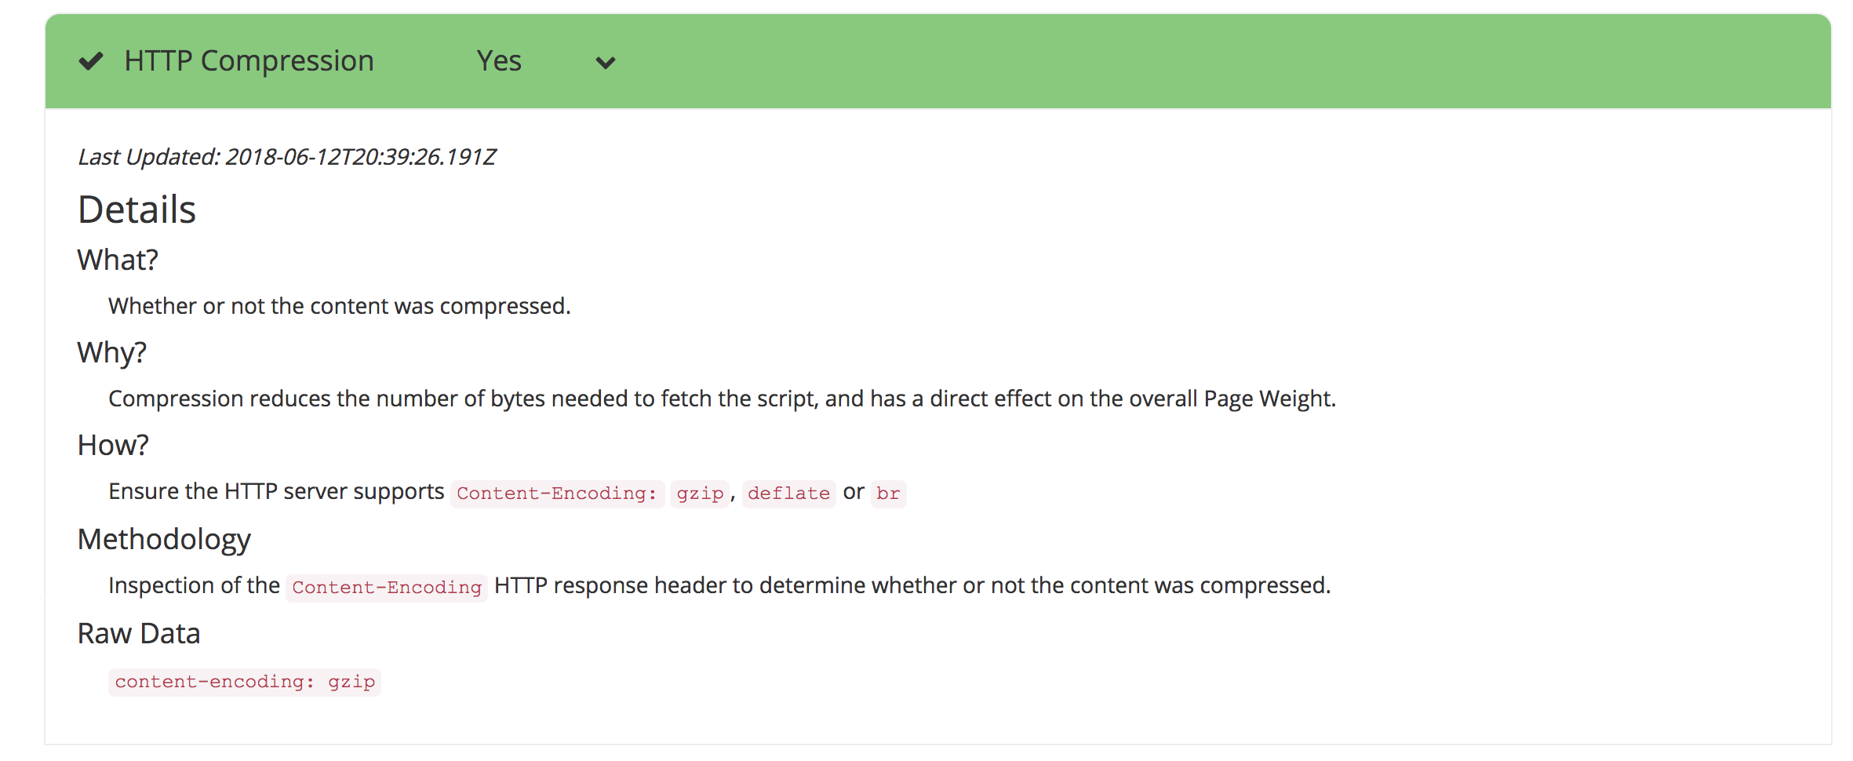
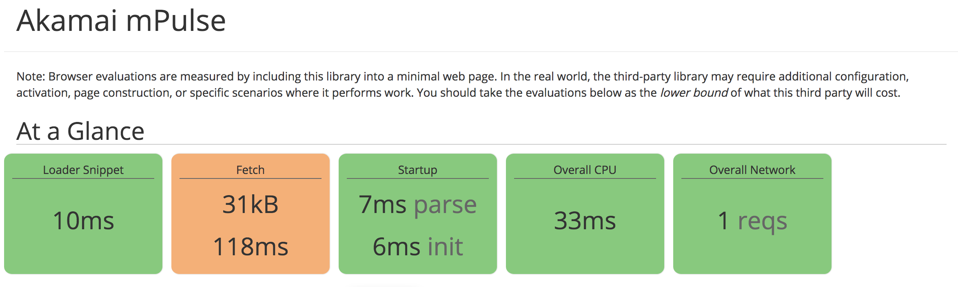
3rdParty.io

Slide 40
Links
https://nicj.net/an-audit-of-boomerangs-performance/
https://nicj.net/boomerang-performance-update/
https://github.com/akamai/boomerang/issues
https://3rdparty.io/

Slide 41
thanks!
nicj.net/talks/

